Slide 1
Numbers Game, Minuscule Kac-Moody Representations, Infinite d-Complete Posets
Robert A. Proctor
UNC Chapel Hill North Carolina USA

Slide 2
Part A: Introduction Part B: Numbers Game Describes Orbits of Weyl Group Part C: Finite Colored Minuscule Posets Part D: Kac-Moody Groups and lambda-Minuscule Elements Part E: Infinite Minuscule & d-Complete Posets, Classsificat’ns Part F: Building Representations from Colored Posets Part G: Classifying Infinite Minuscule Structures

Slide 3
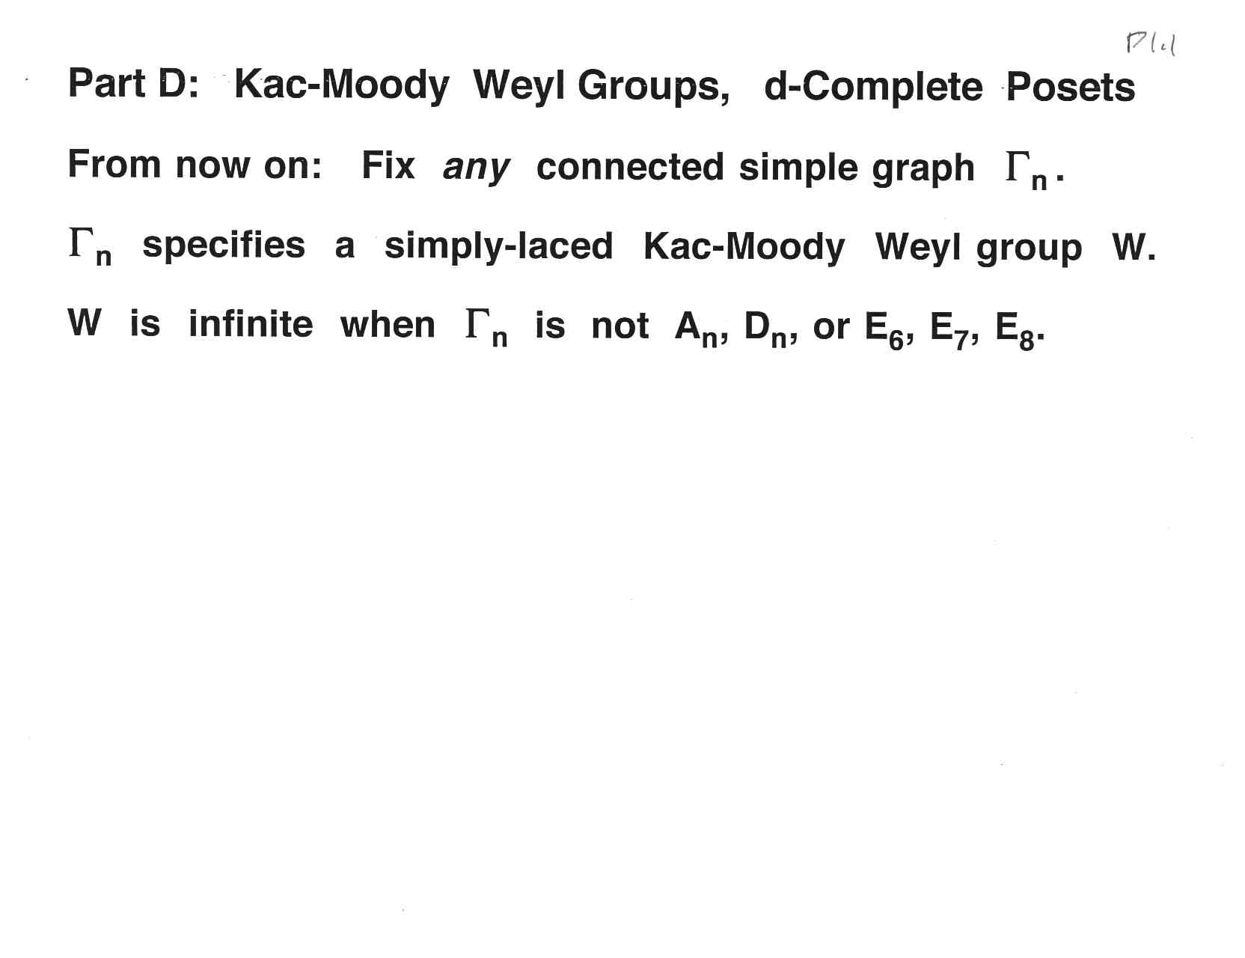
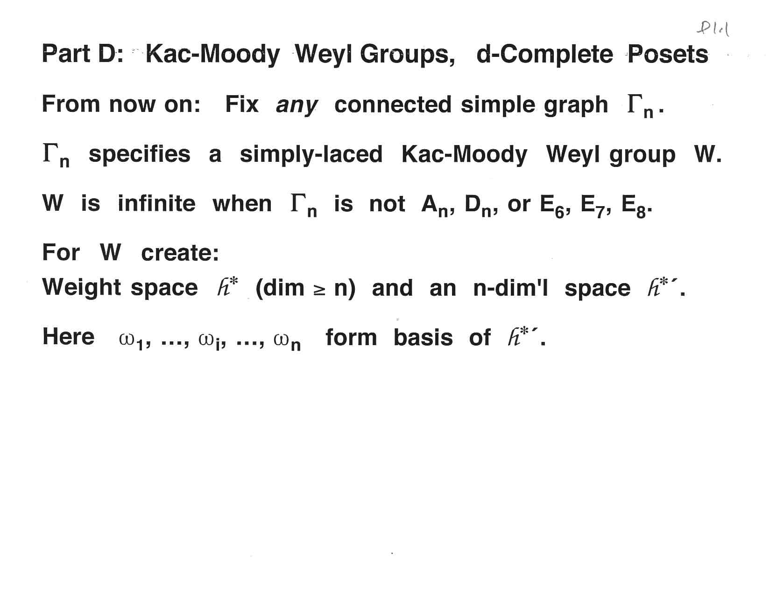

Slide 4
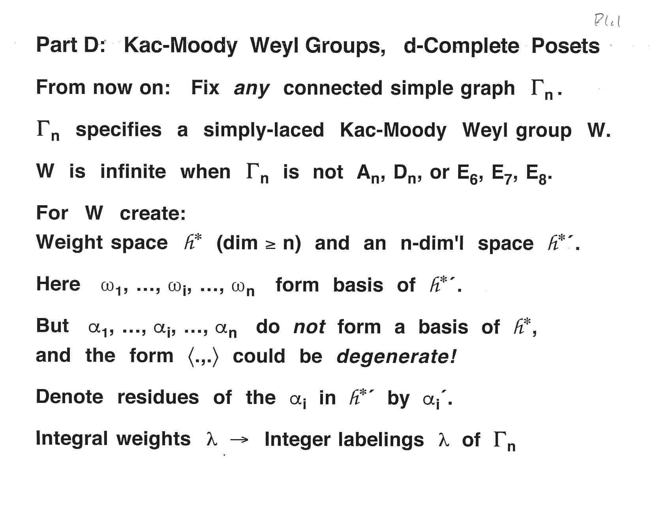

Slide 12
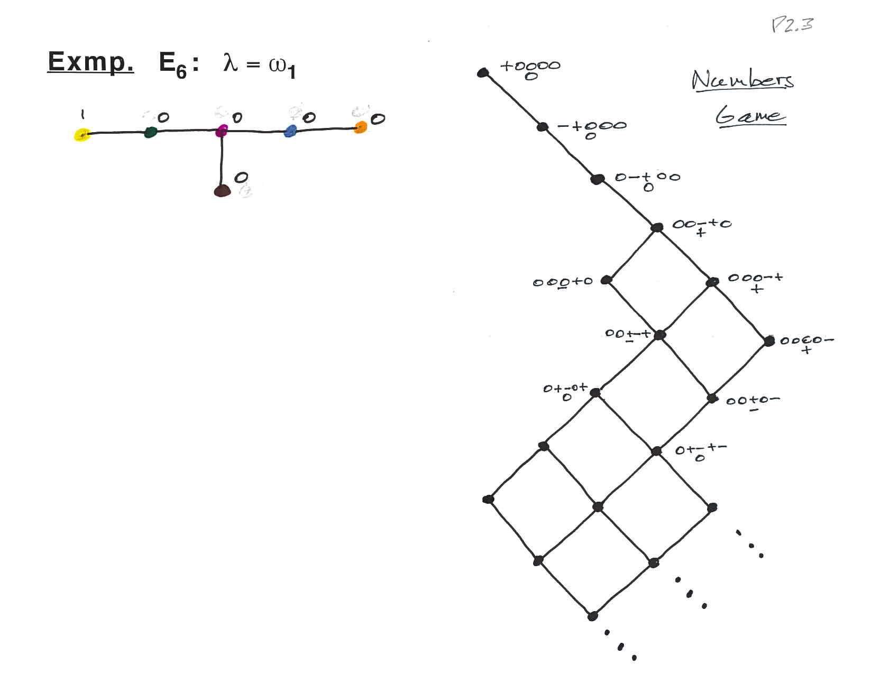

Slide 13
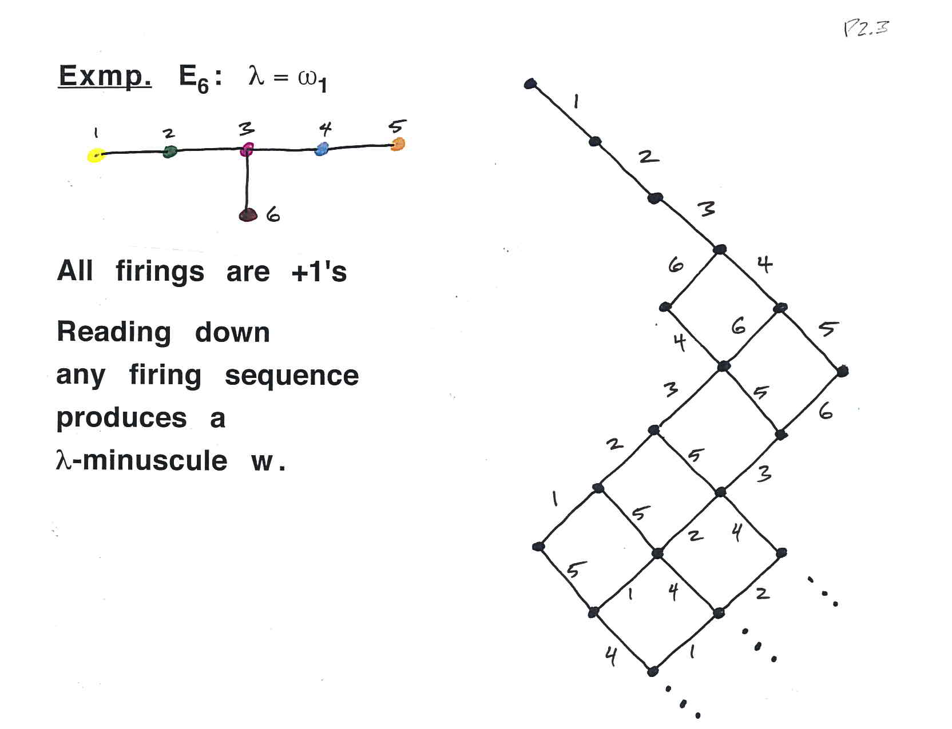

Slide 15
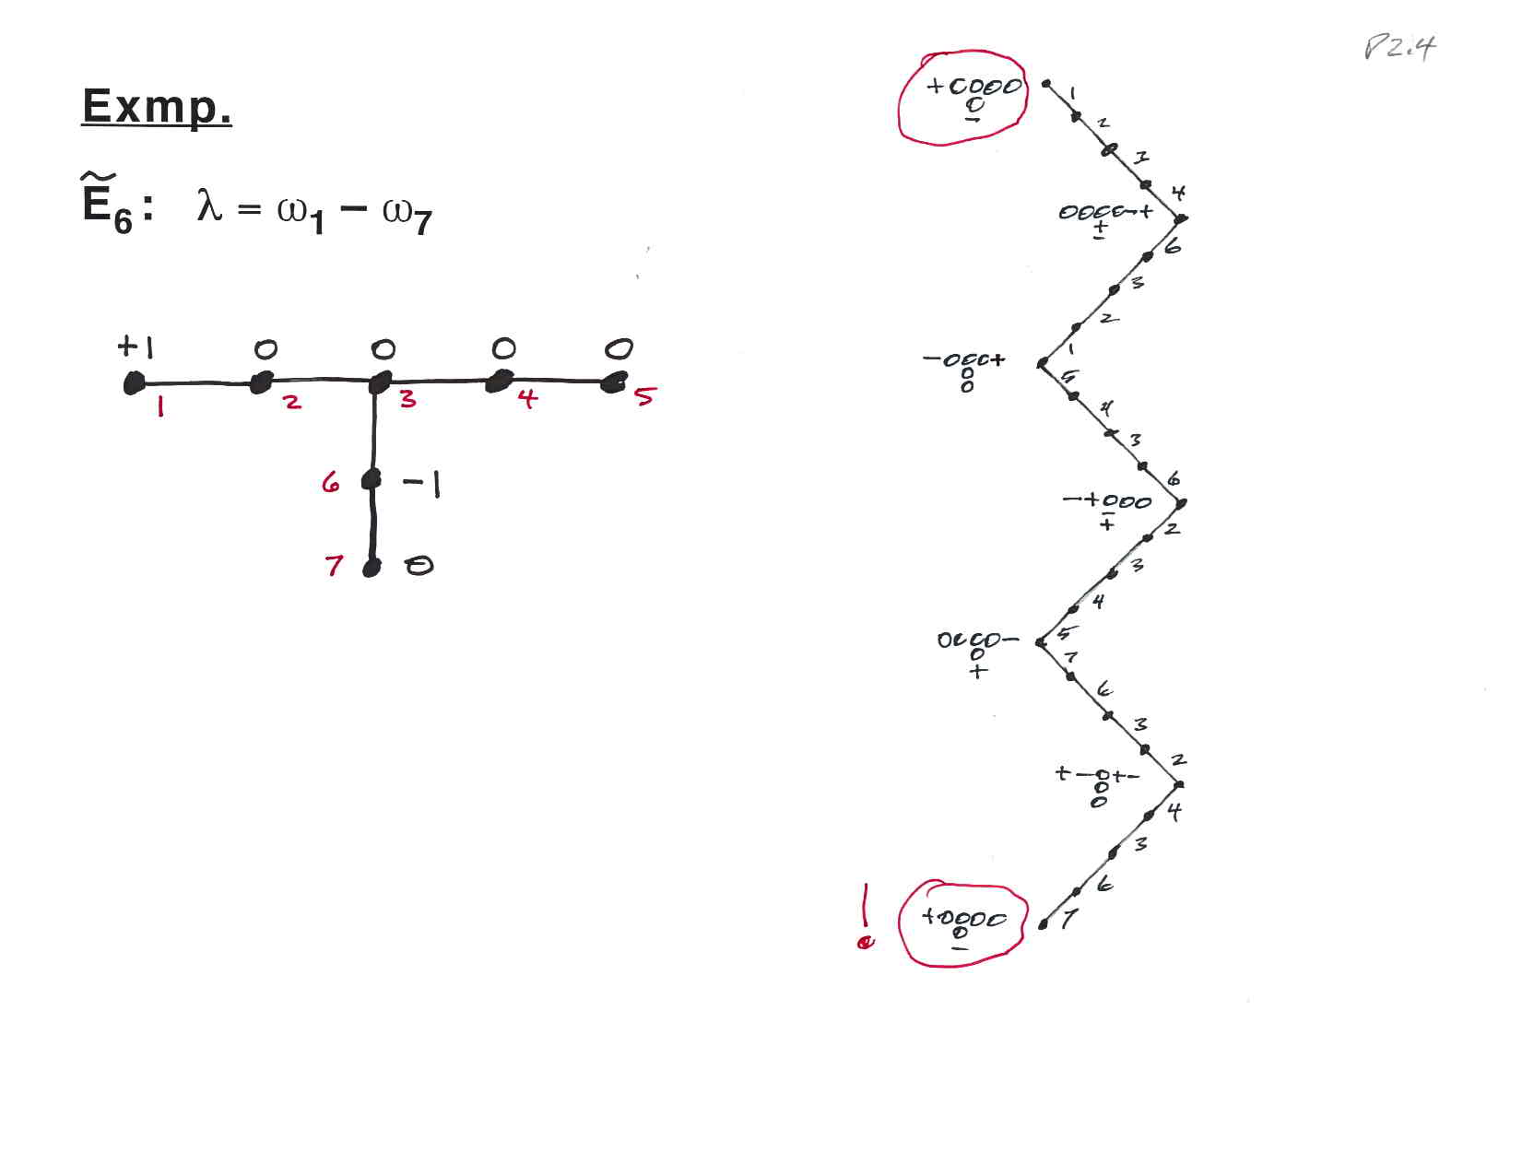

Slide 16
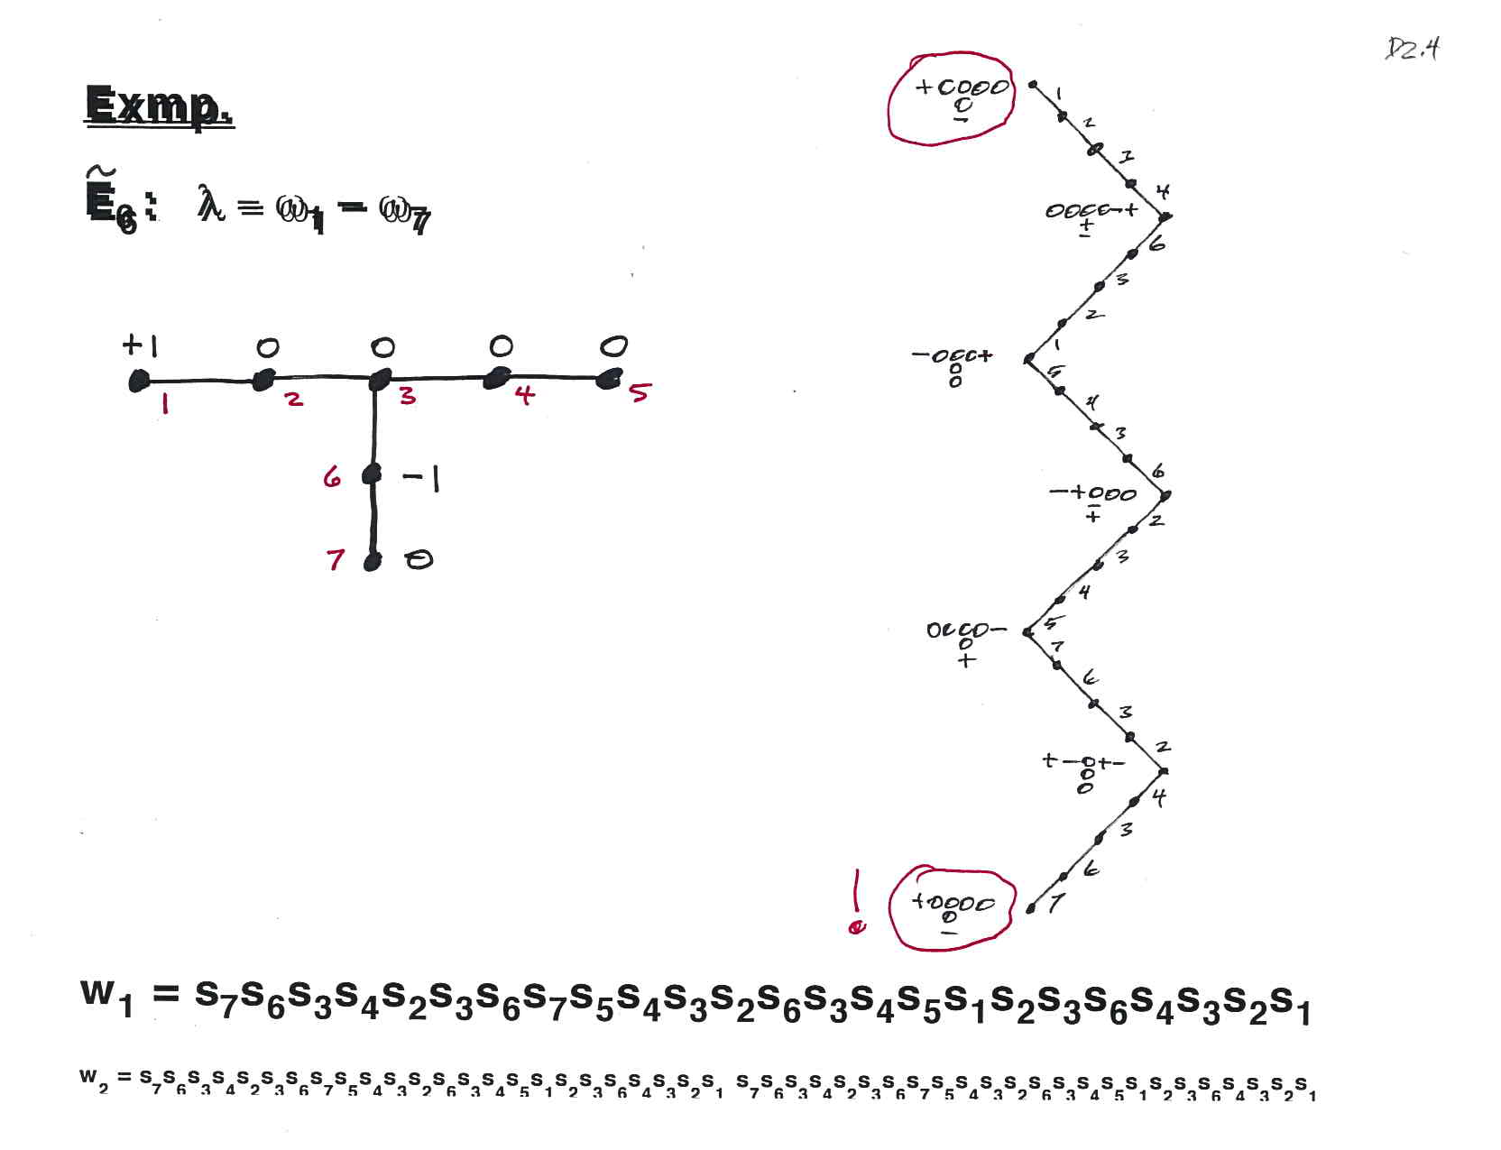

Slide 17
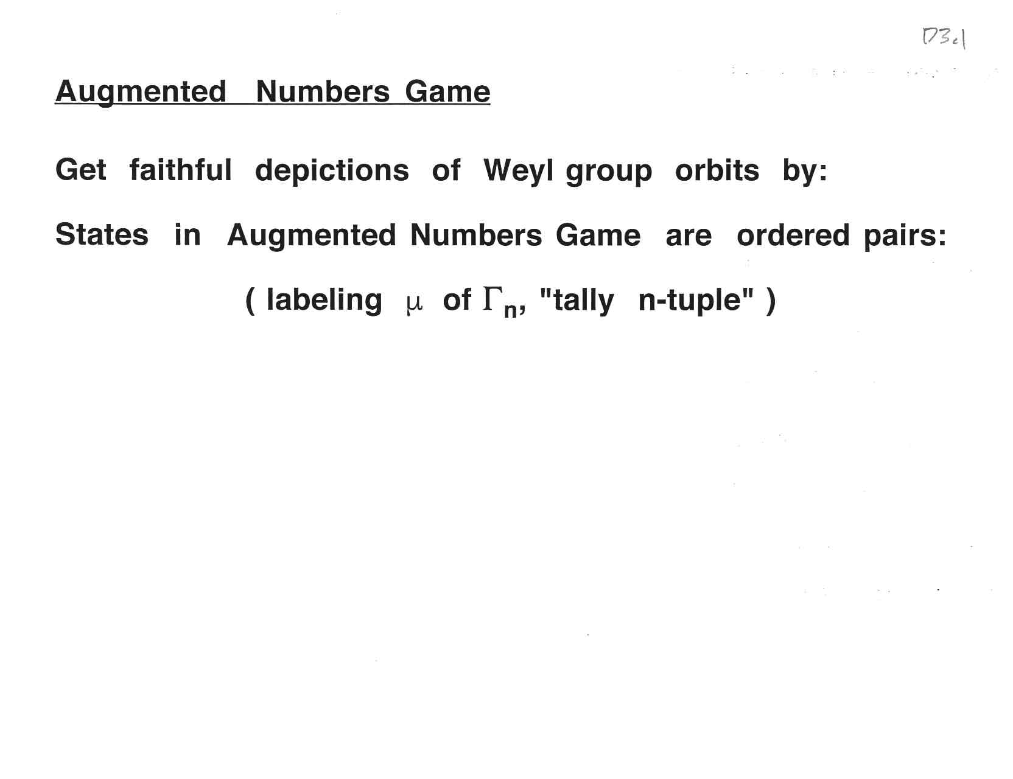

Slide 29
Part A: Introduction Part B: Numbers Game Describes Orbits of Weyl Group Part C: Finite Colored Minuscule Posets Part D: Kac-Moody Groups and lambda-Minuscule Elements Part E: Infinite Minuscule & d-Complete Posets, Classsificat’ns Part F: Building Representations from Colored Posets Part G: Classifying Infinite Minuscule Structures

Slide 33
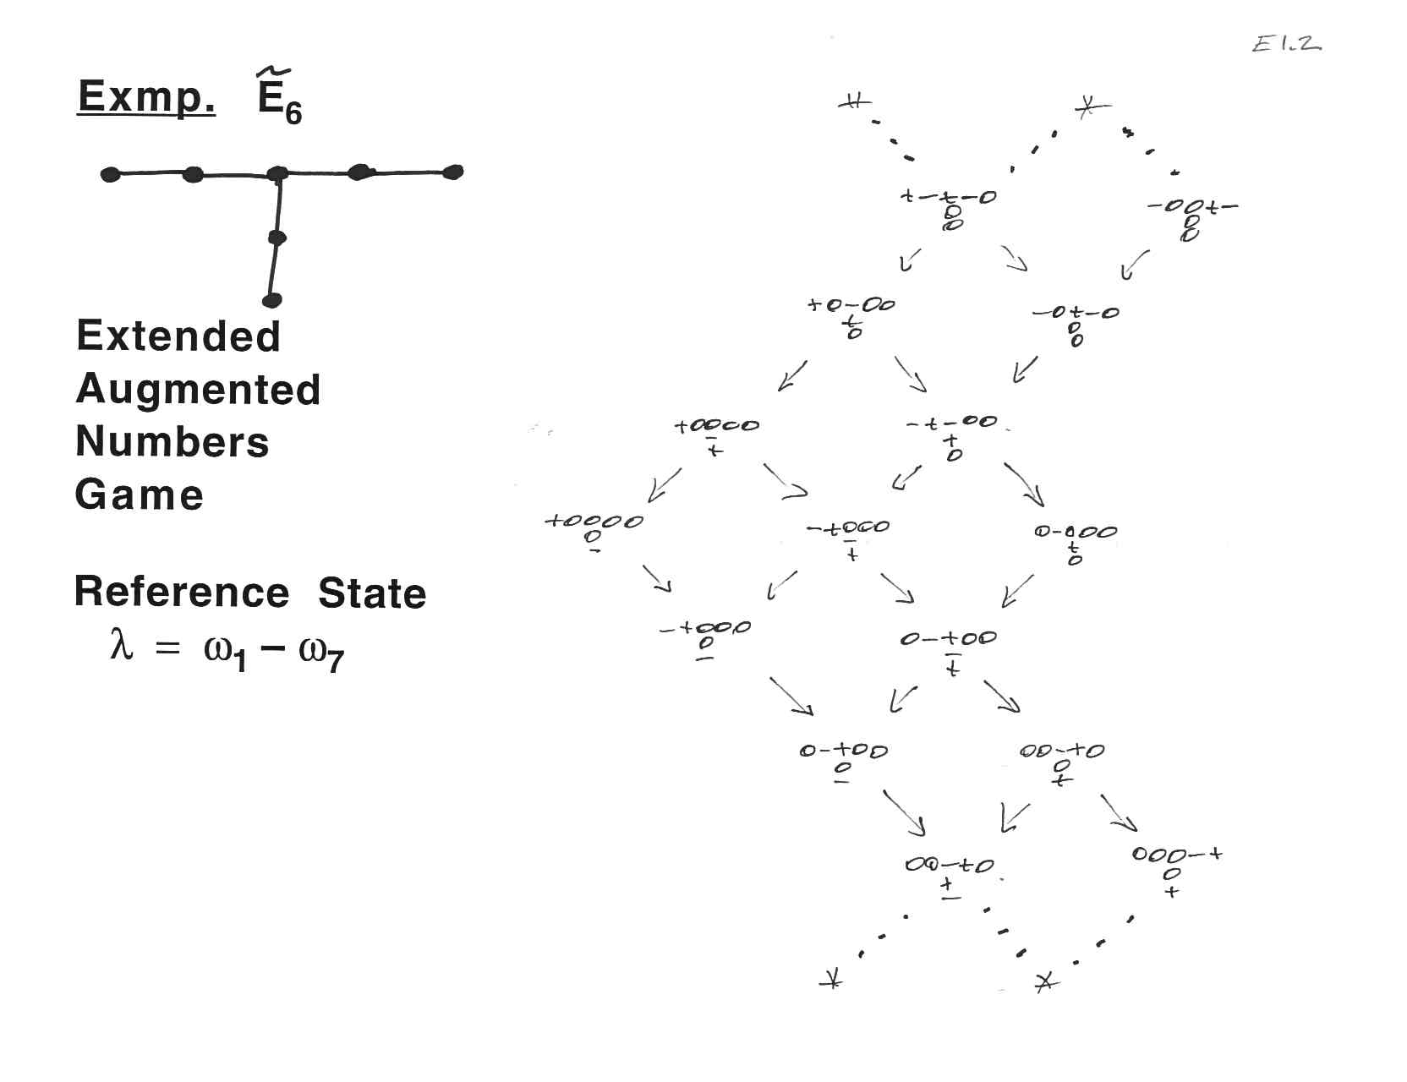

Slide 38
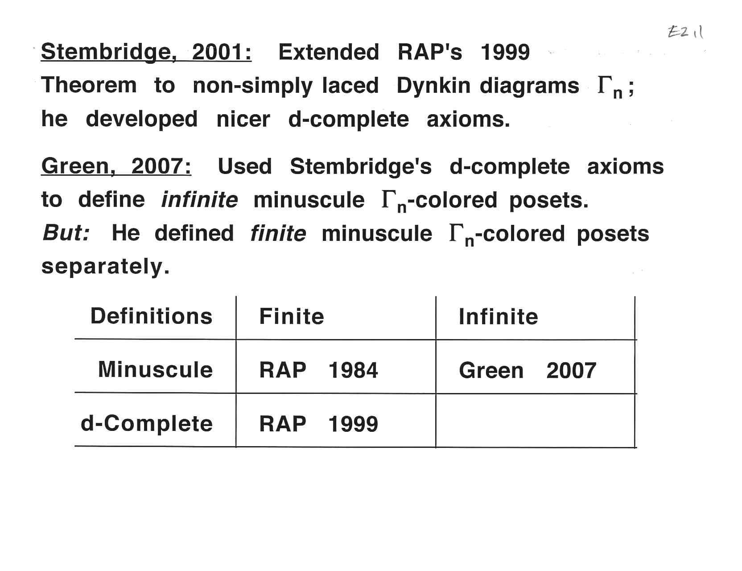

Slide 39
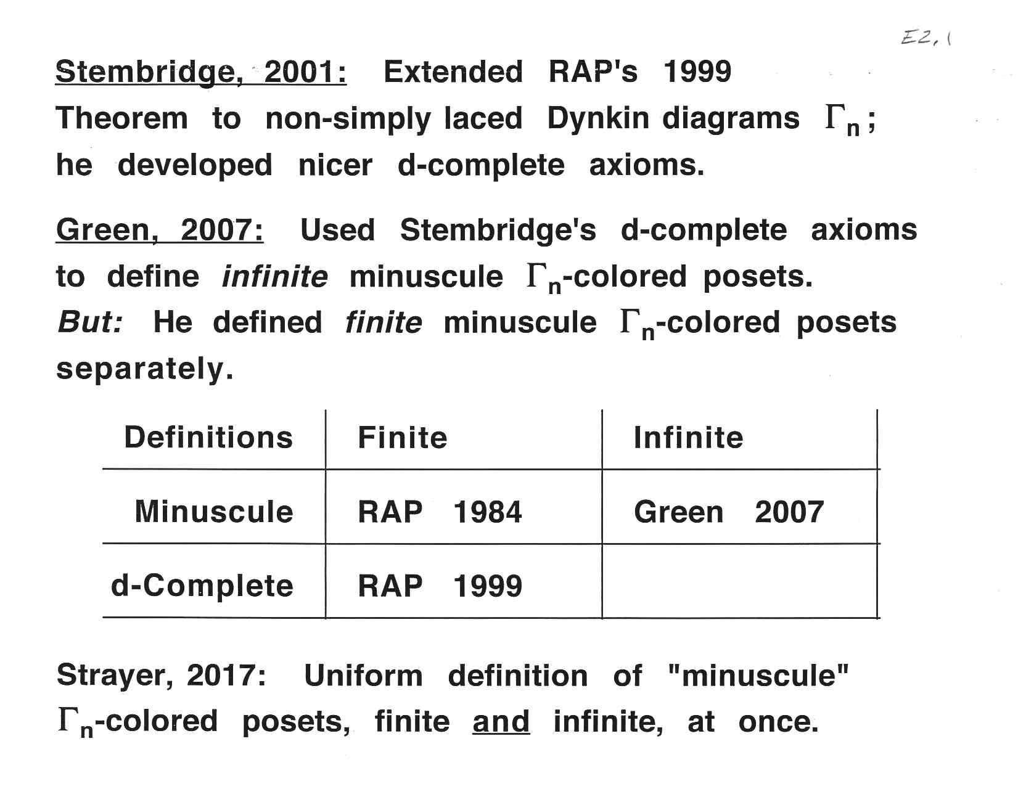

Slide 40
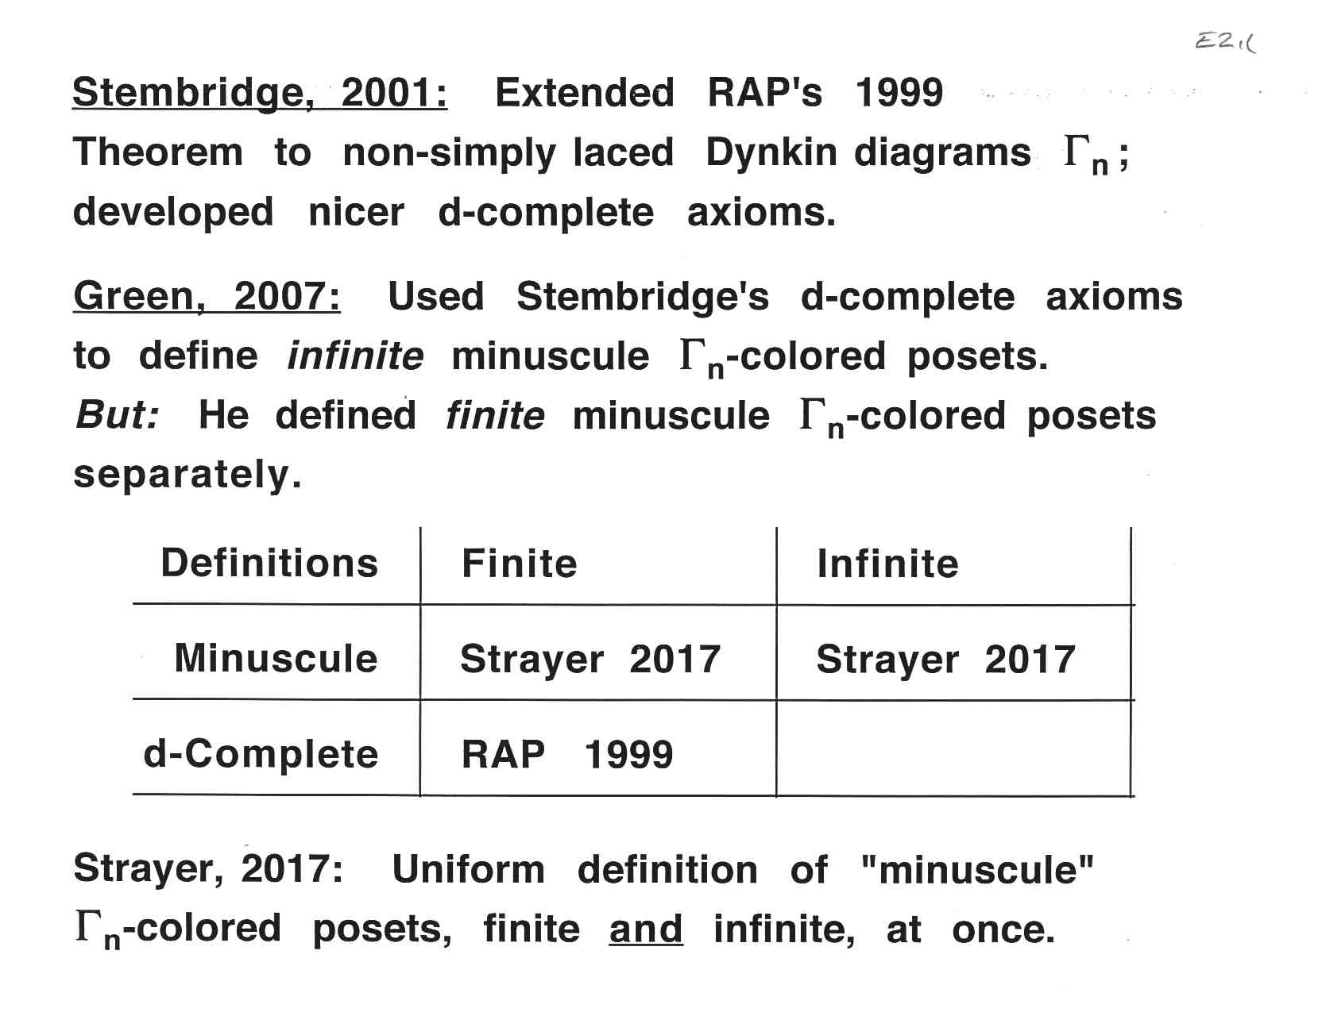

Slide 46
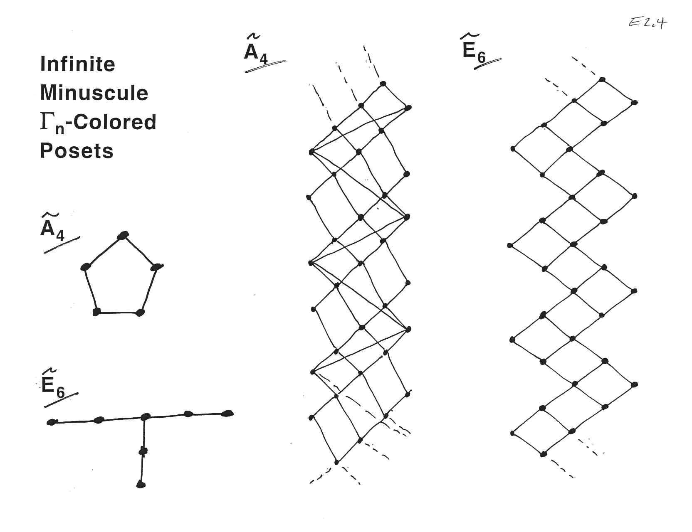

Slide 47
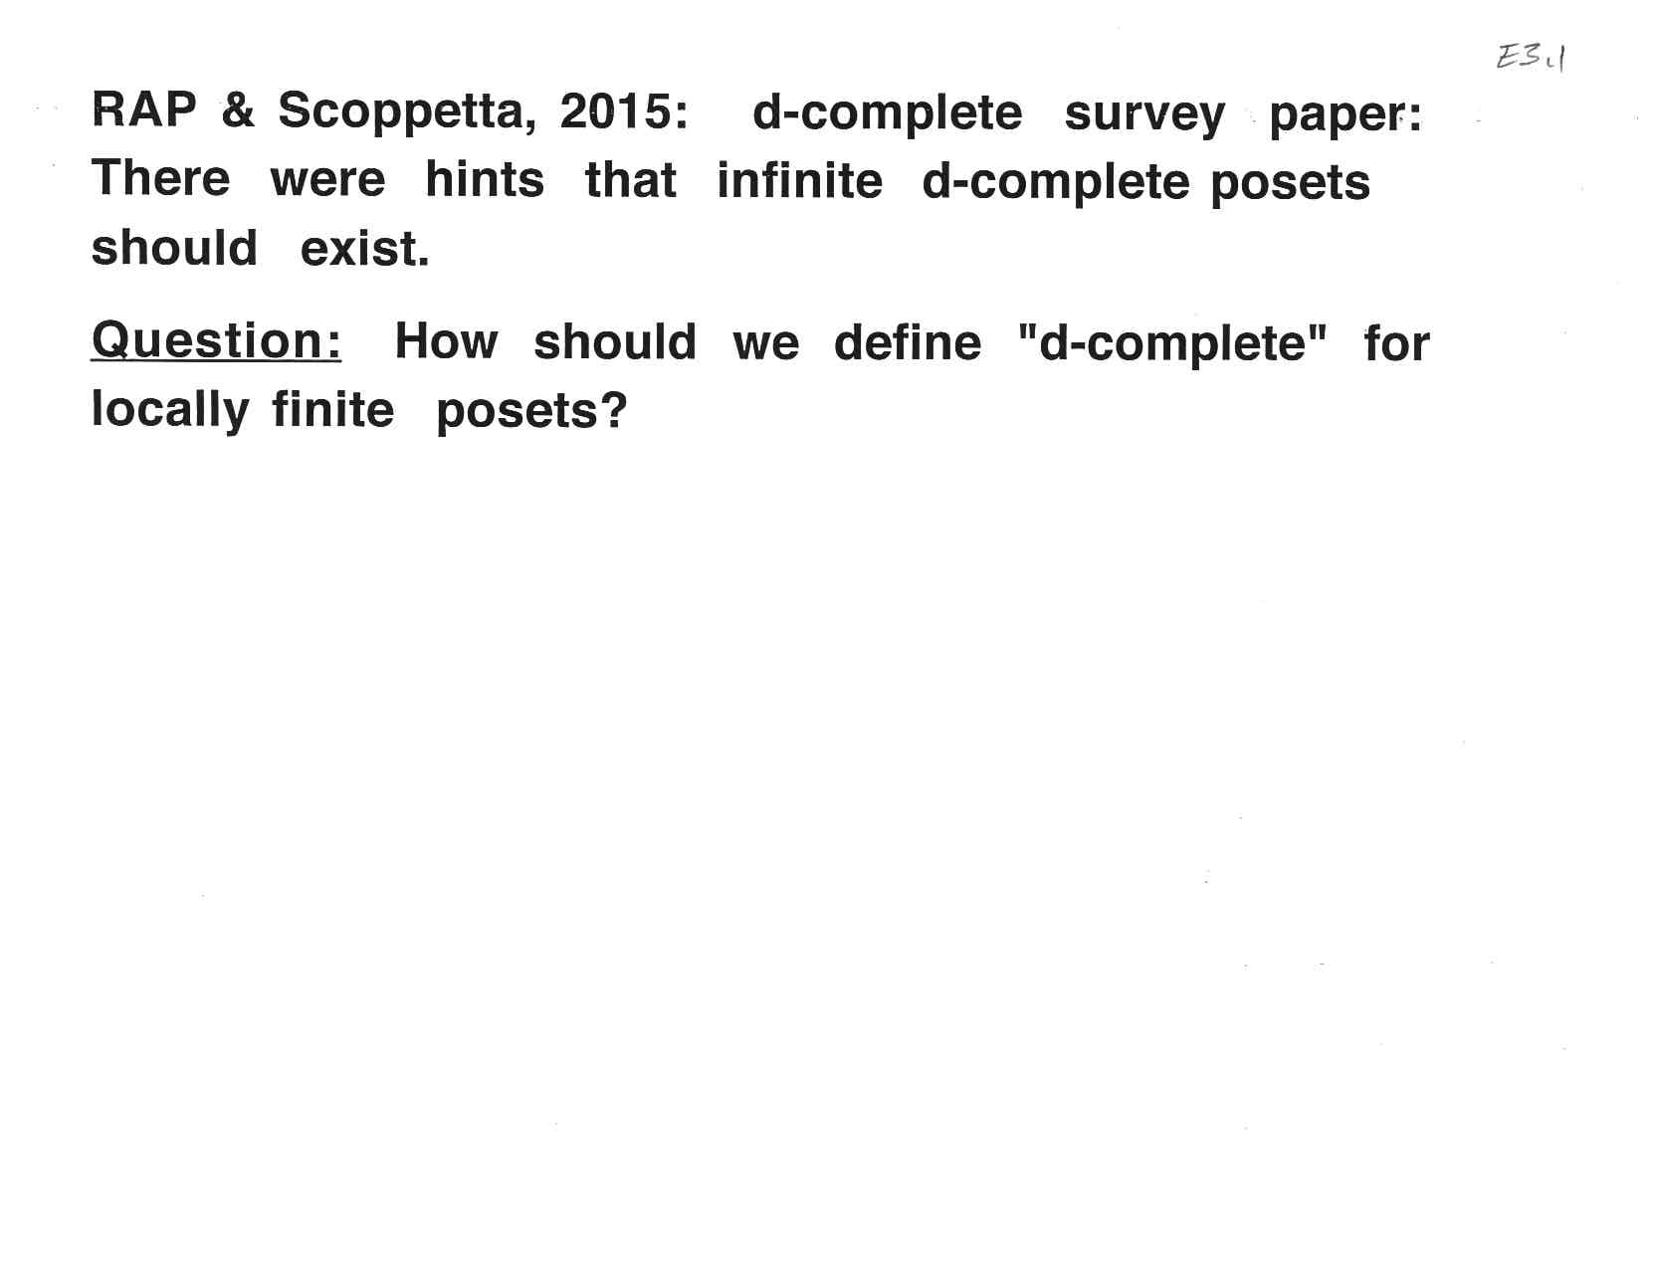

Slide 49
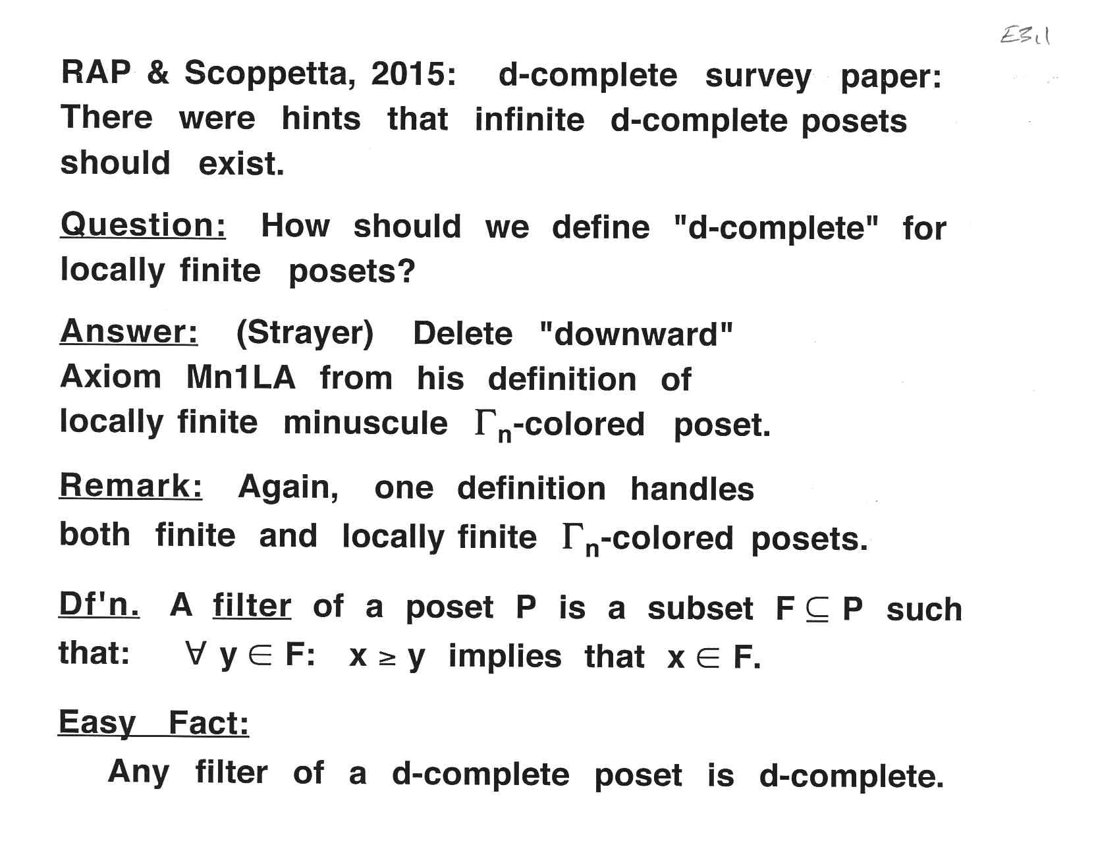

Slide 50
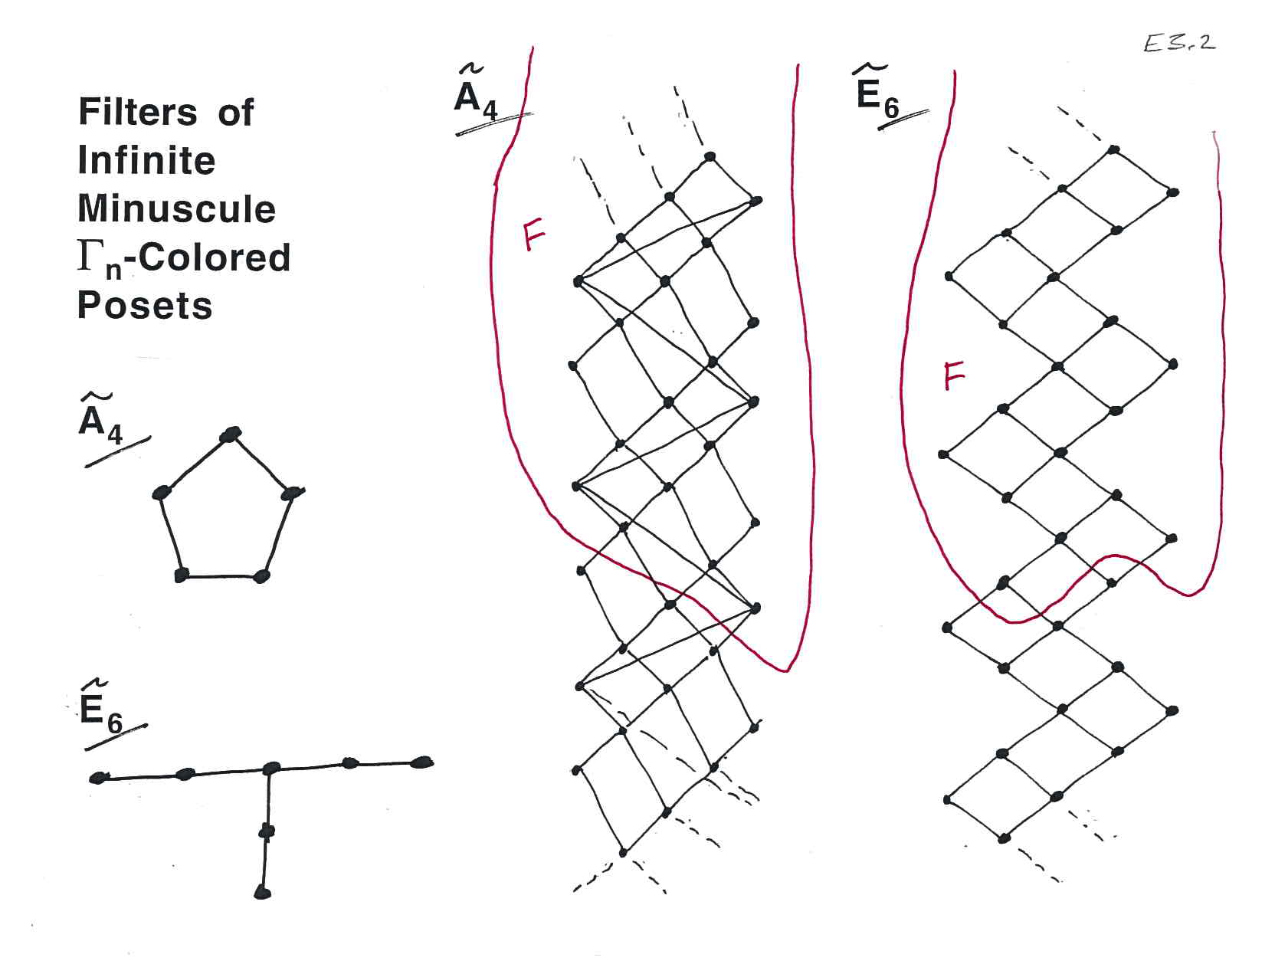

Slide 51
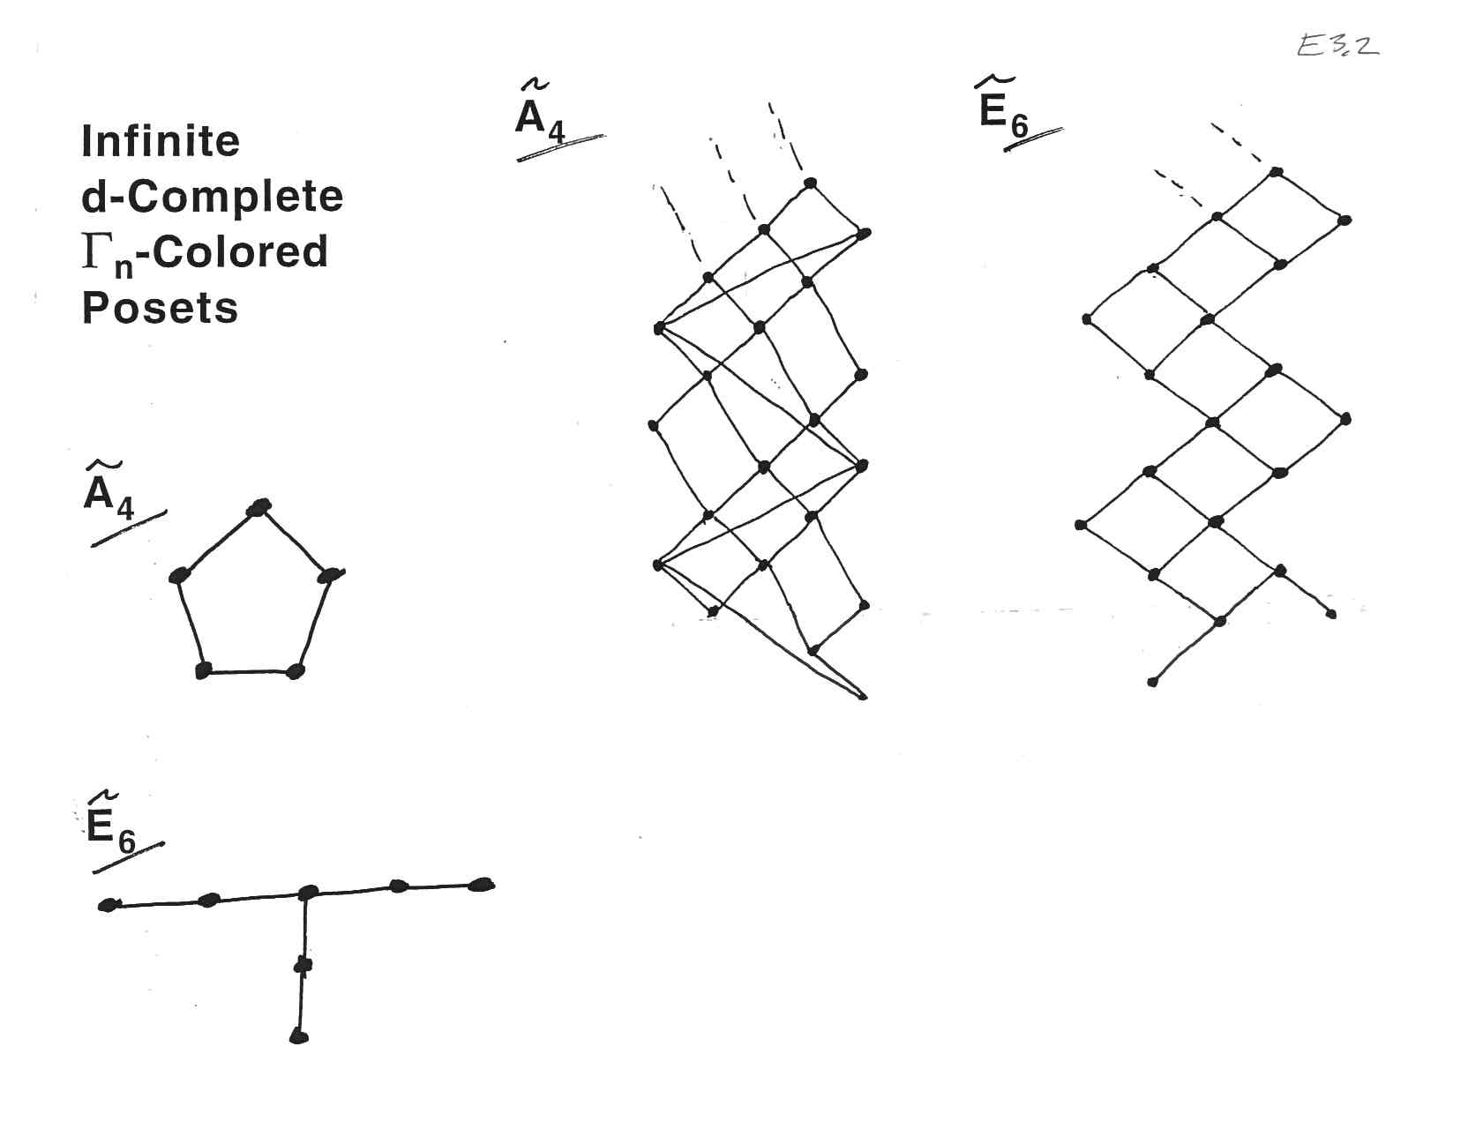

Slide 52
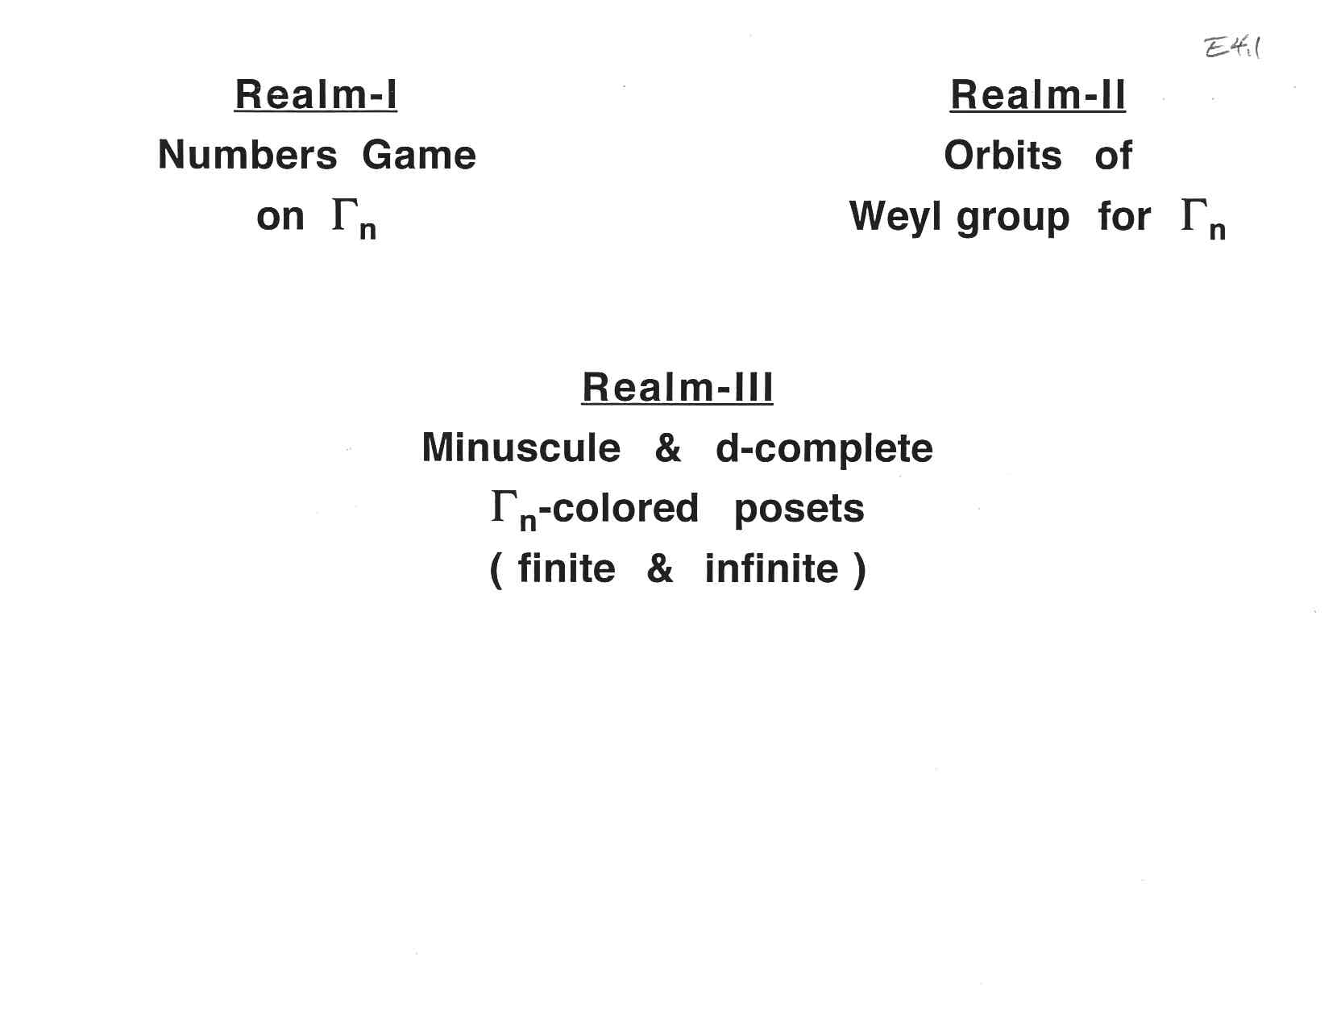

Slide 53
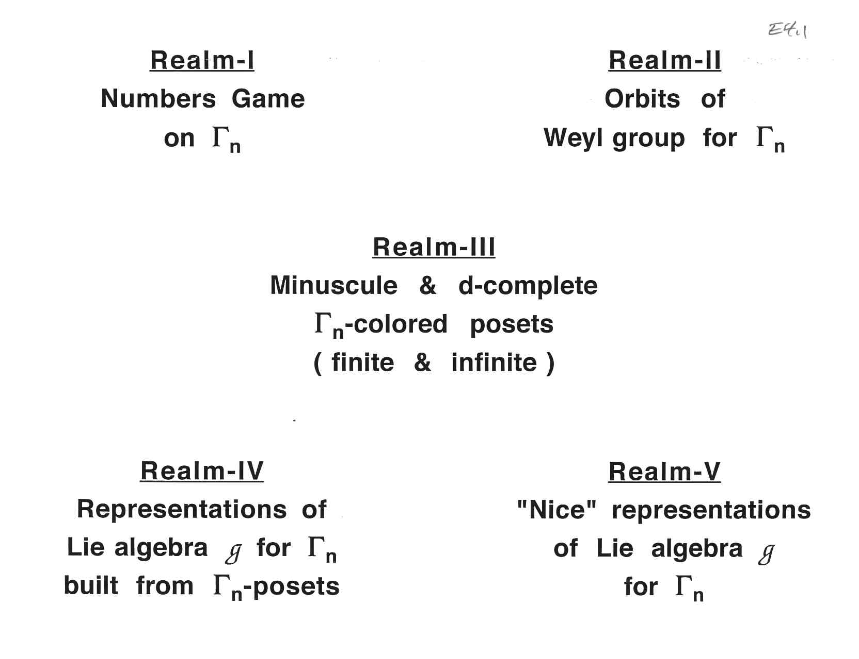

Slide 56
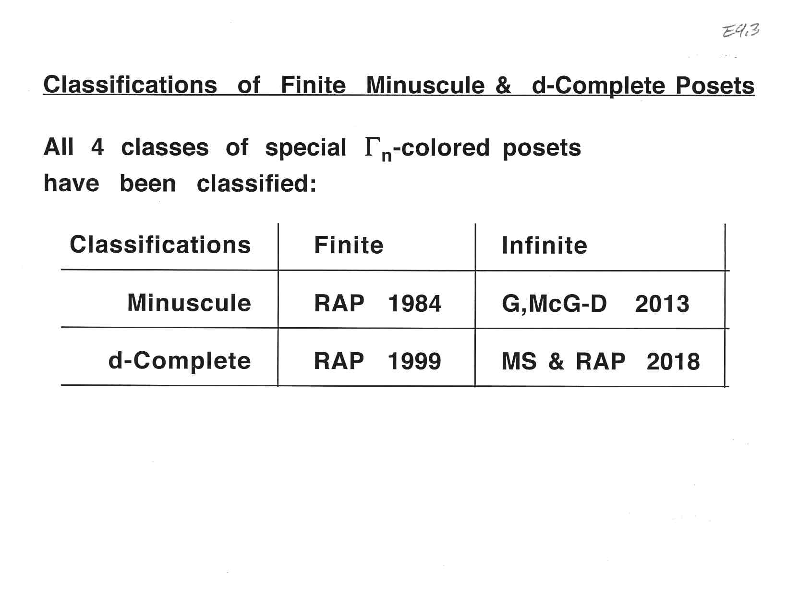

Slide 58
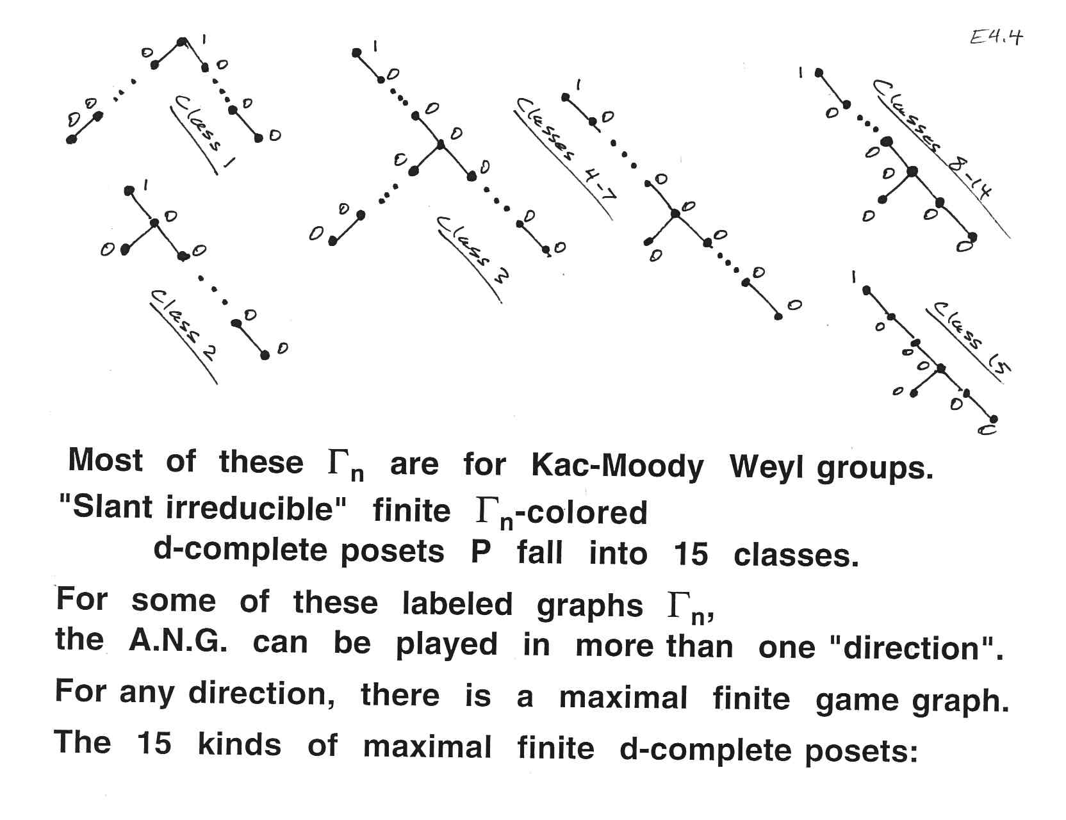

Slide 59
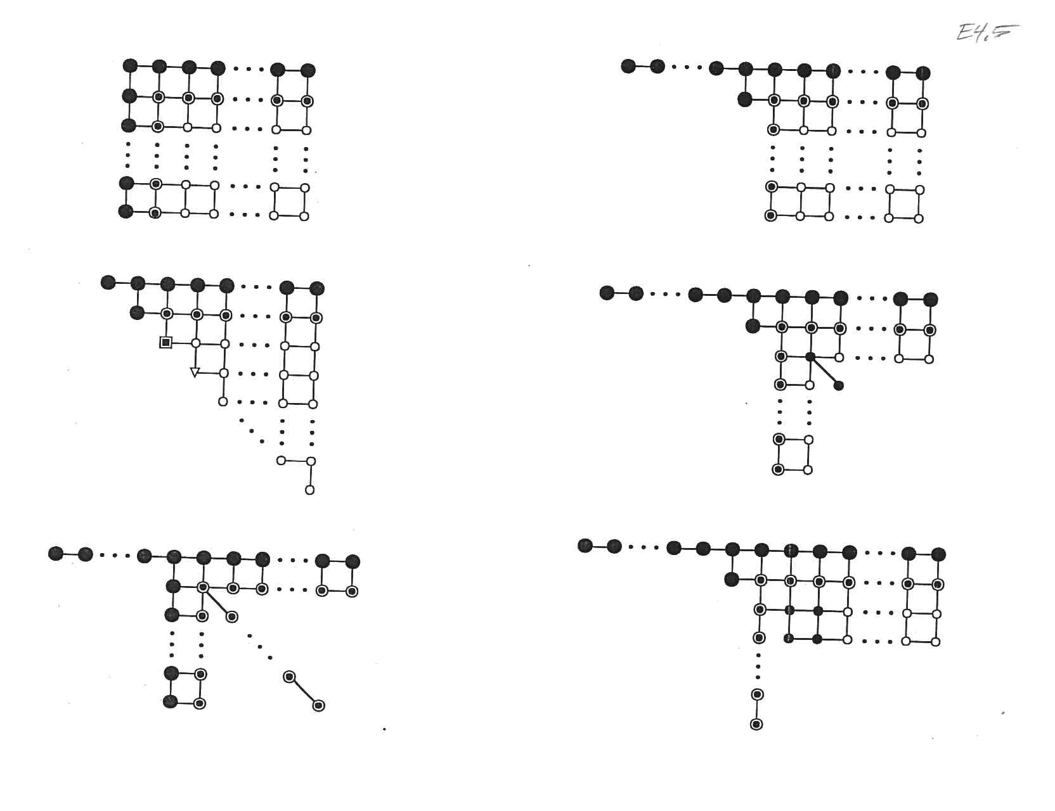

Slide 60
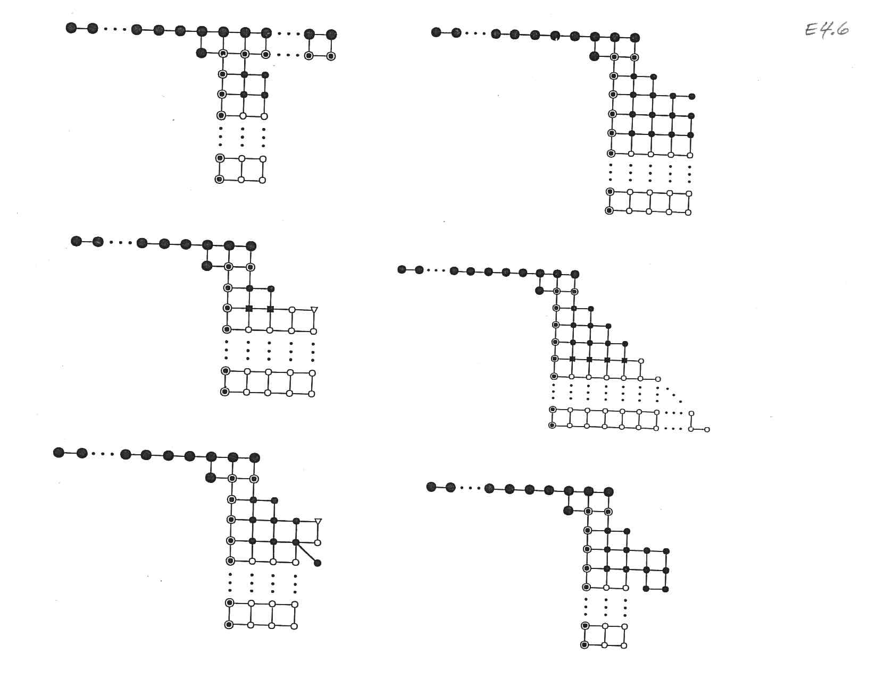

Slide 61
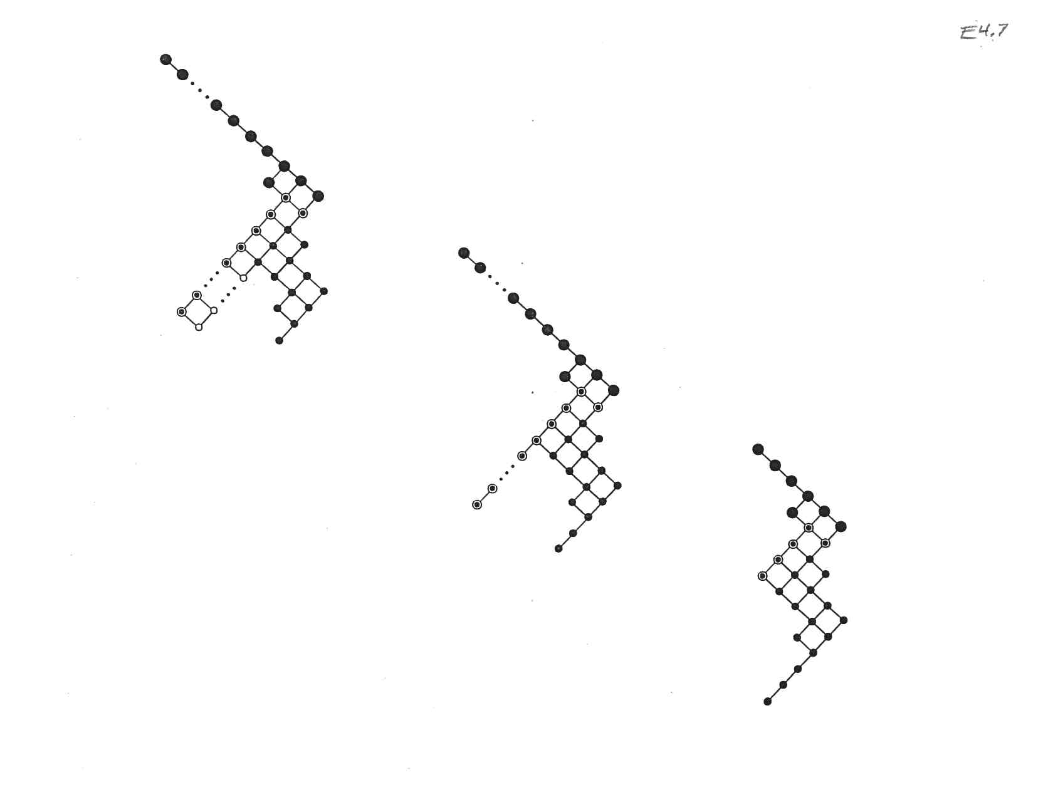

Slide 62
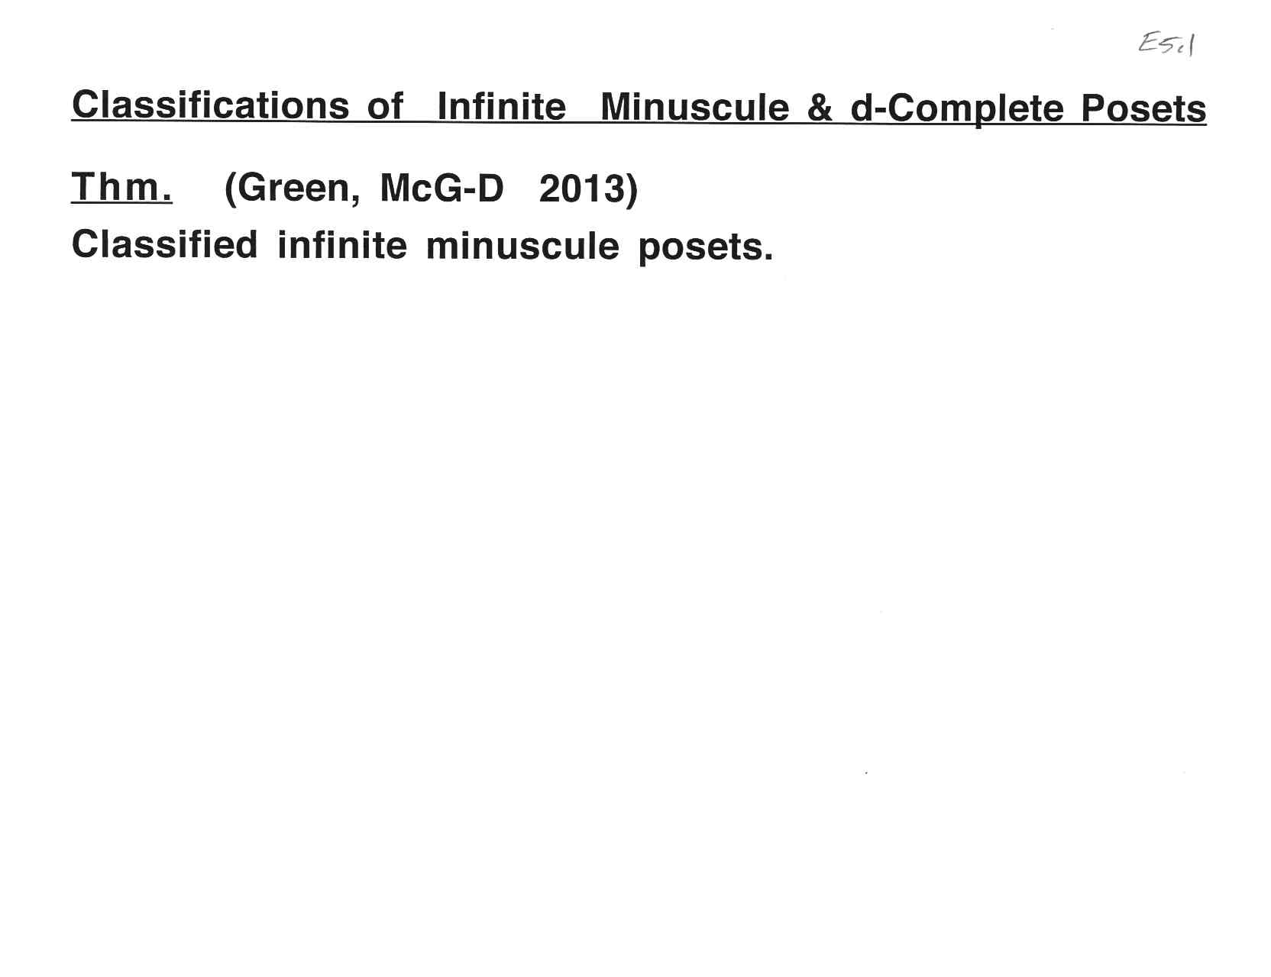

Slide 68
Part A: Introduction Part B: Numbers Game Describes Orbits of Weyl Group Part C: Finite Colored Minuscule Posets Part D: Kac-Moody Groups and lambda-Minuscule Elements Part E: Infinite Minuscule & d-Complete Posets, Classsificat’ns Part F: Building Representations from Colored Posets Part G: Classifying Infinite Minuscule Structures

Slide 71
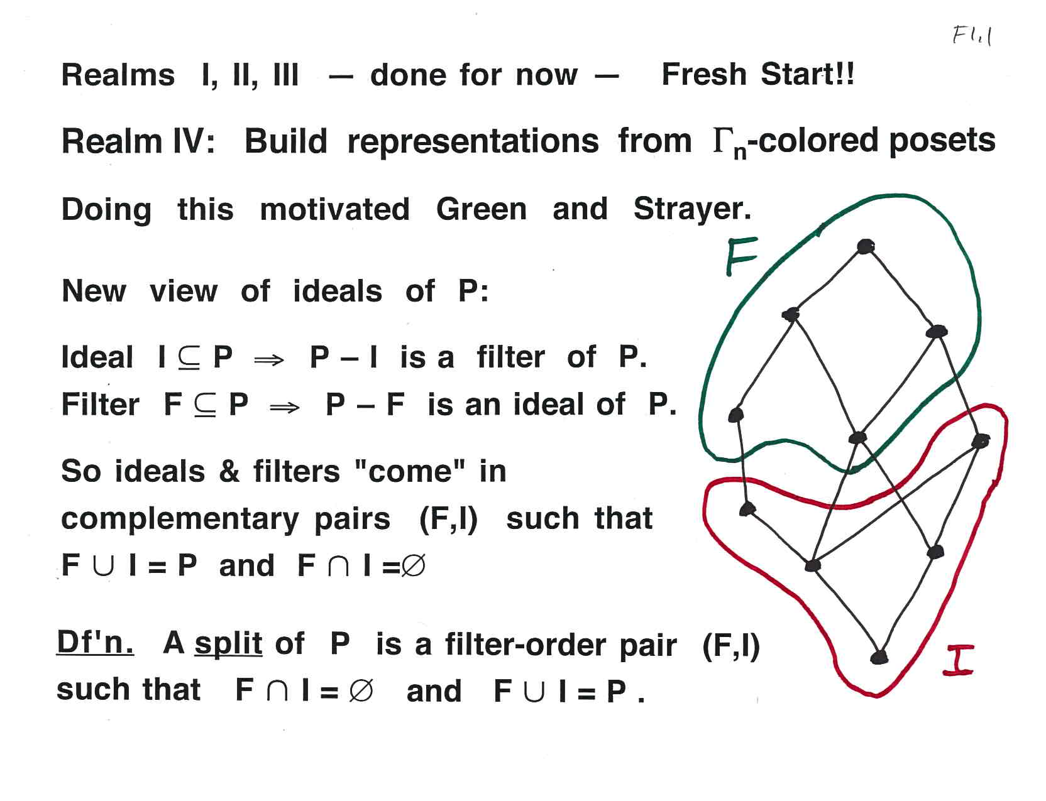

Slide 86
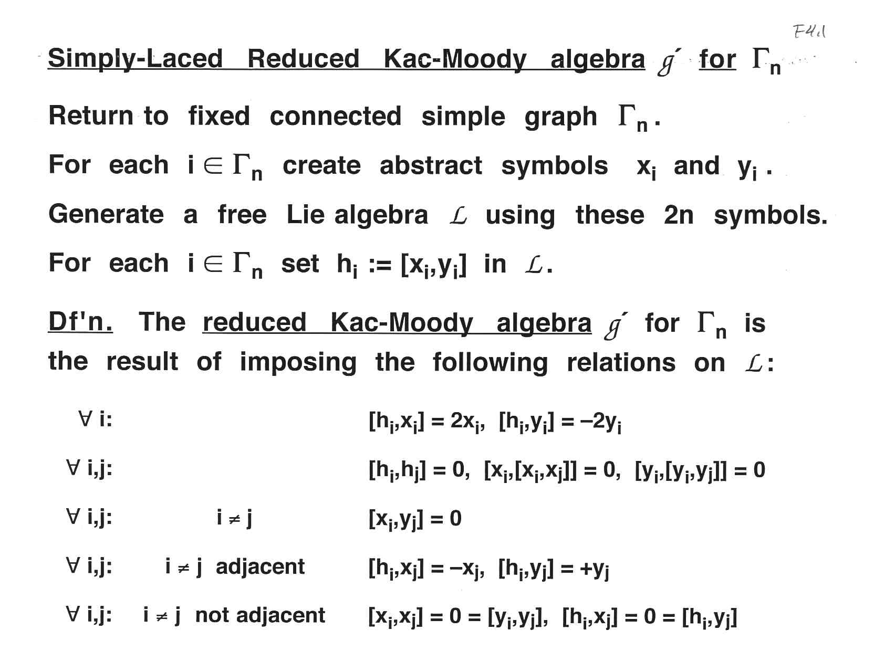

Slide 96
Part A: Introduction Part B: Numbers Game Describes Orbits of Weyl Group Part C: Finite Colored Minuscule Posets Part D: Kac-Moody Groups and lambda-Minuscule Elements Part E: Infinite Minuscule & d-Complete Posets, Classsificat’ns Part F: Building Representations from Colored Posets Part G: Classifying Infinite Minuscule Structures

Slide 98
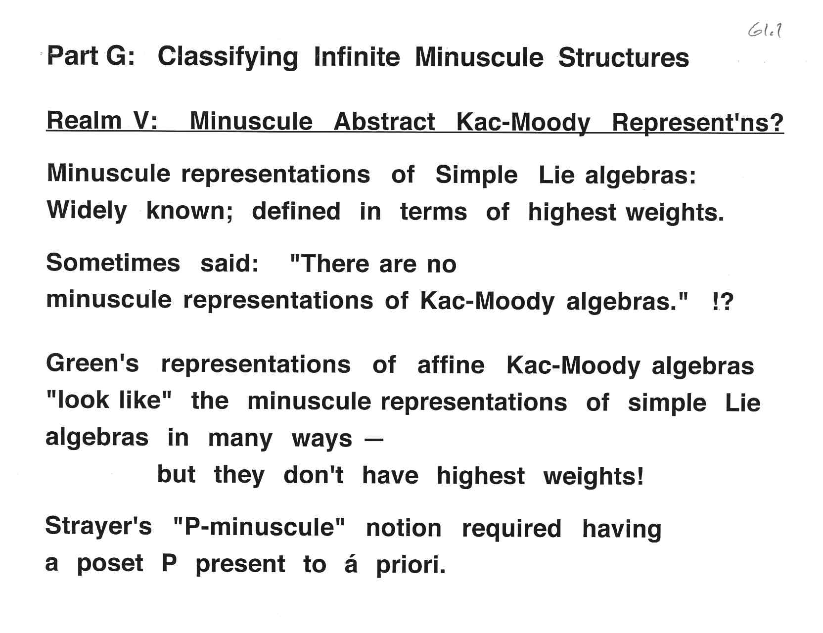

Slide 101
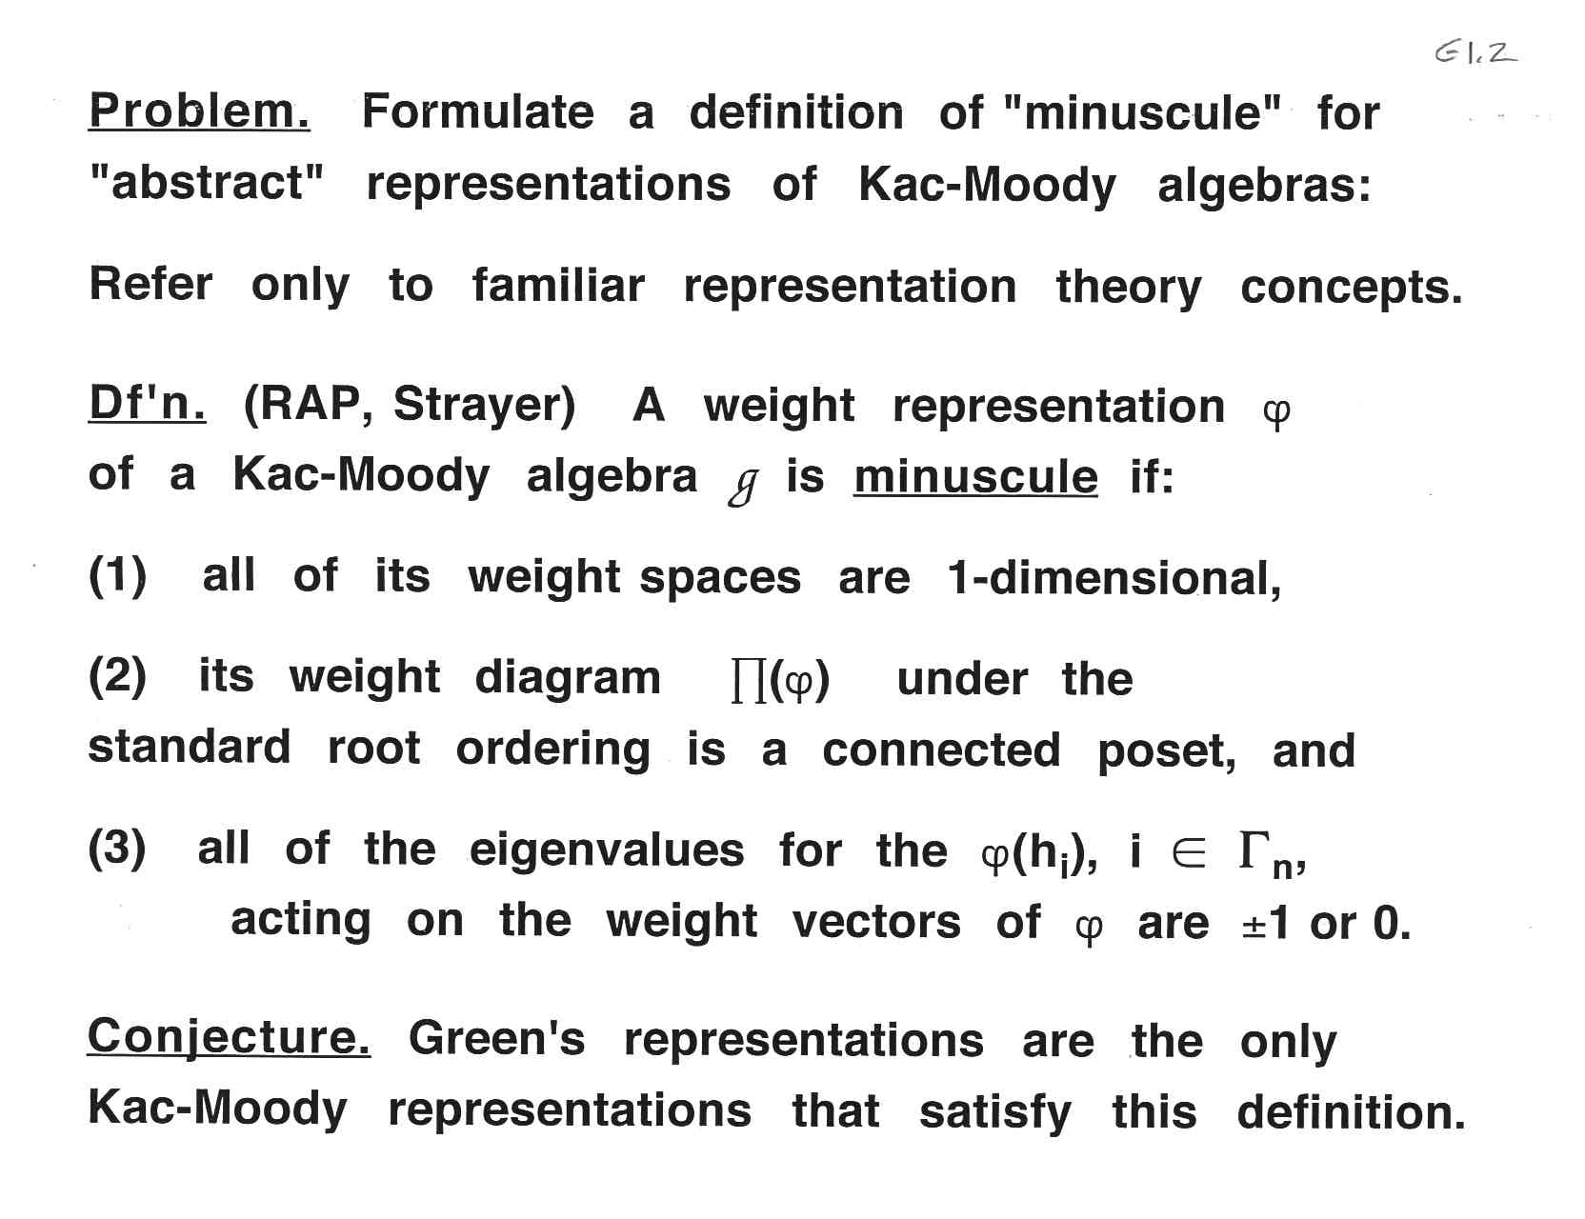

Slide 104
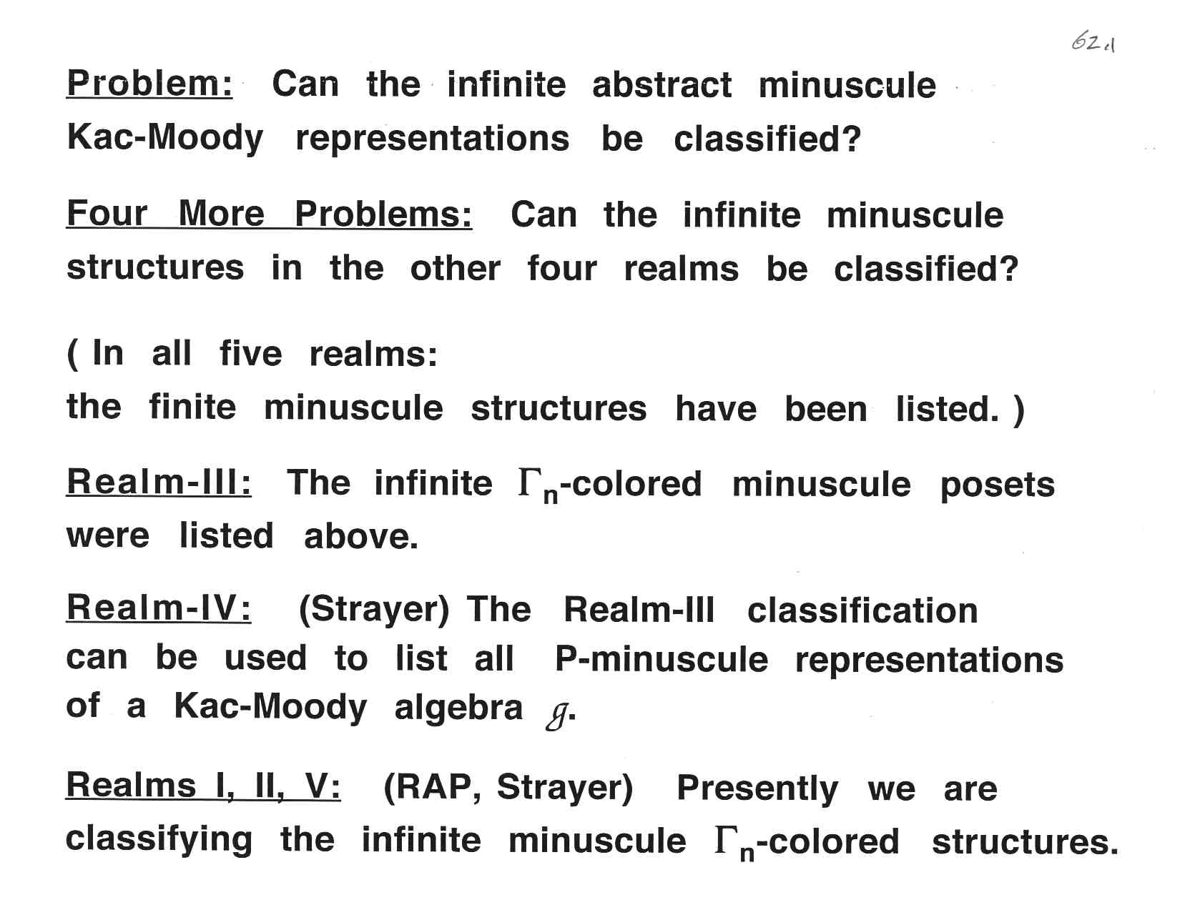

Slide 107
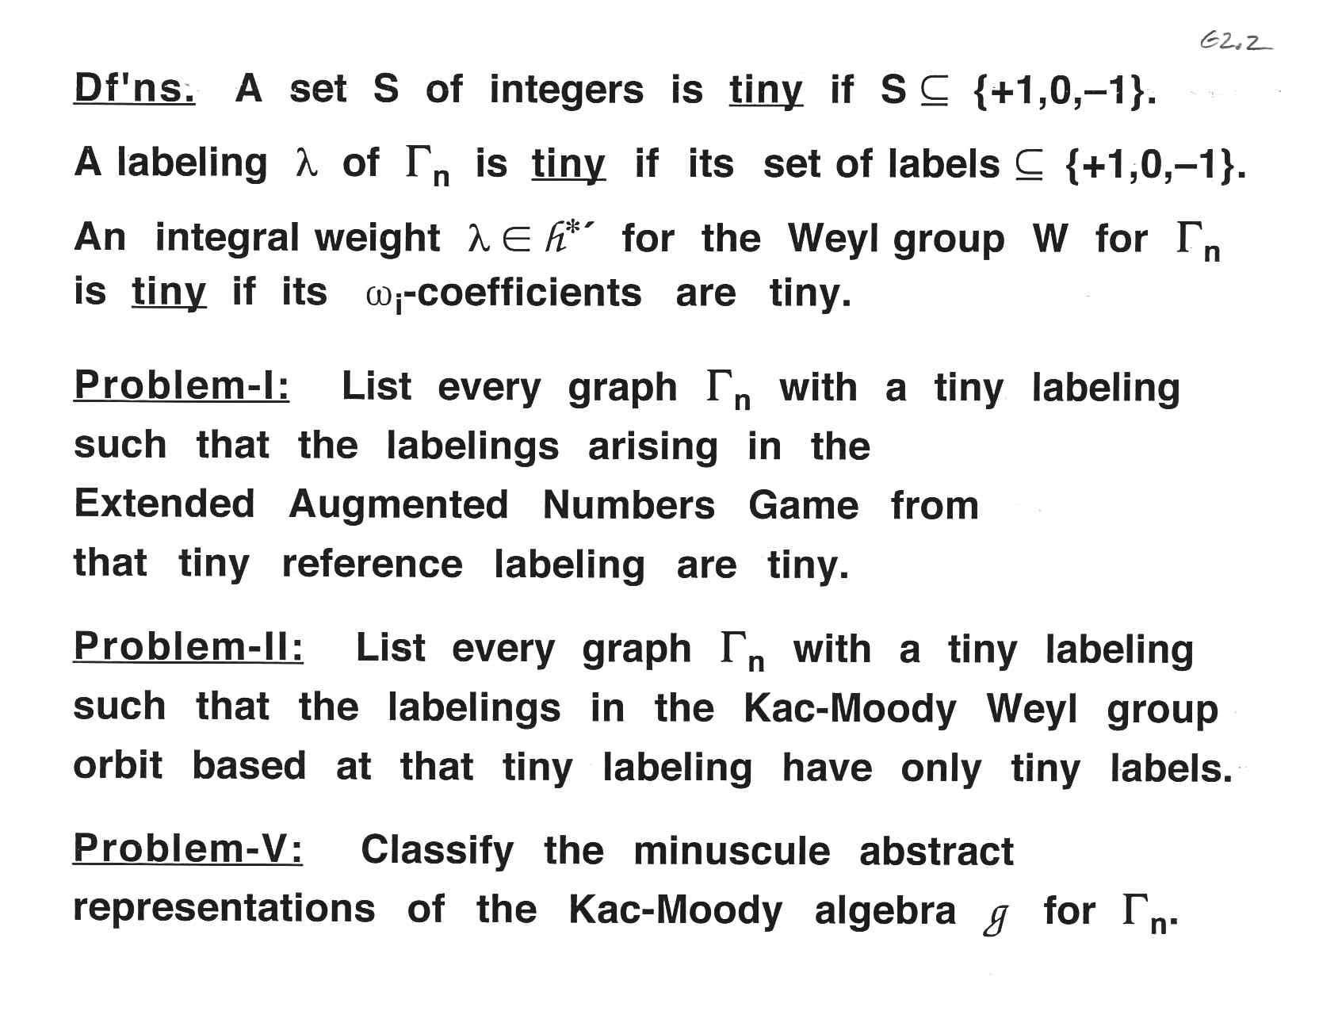

Slide 111
Part A: Introduction Part B: Numbers Game Describes Orbits of Weyl Group Part C: Finite Colored Minuscule Posets Part D: Kac-Moody Groups and lambda-Minuscule Elements Part E: Infinite Minuscule & d-Complete Posets, Classsificat’ns Part F: Building Representations from Colored Posets Part G: Classifying Infinite Minuscule Structures

